Slide 1


Name :- Juned Saleh (0805065) Aayush Vaishnav (0805055) Ishwari Upadhyay(0799812) Course :- Capstone Project(DAB-402) Instructor :- Prof. Matt Mostofi

Slide 2


Project Title
Sentiment Analysis on Opening of FIFA World cup Qatar 2022
This Photo by Unknown Author is licensed under CC BY-SA

Slide 3
AGENDA
Introduction
Project Overview
Work flow
Dataset and pre-processing
EDA
Model building
Model evaluation
Limitations
Conclusion
References
Profits are up in the last quarter by 3%

Slide 4
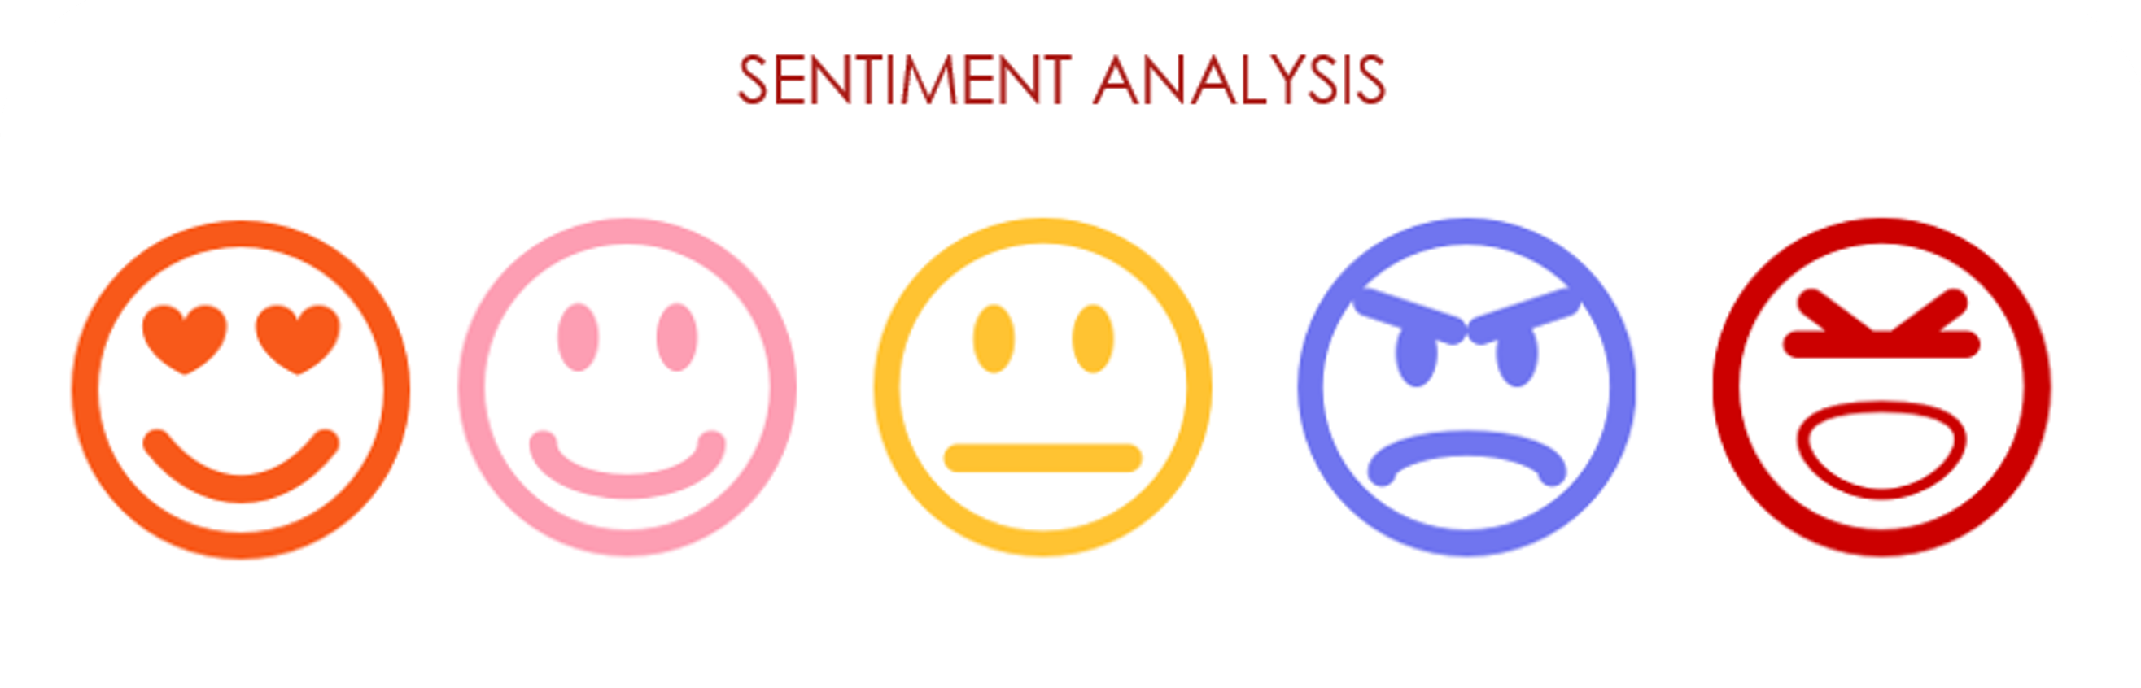
INTRODUCTION
What IS SENTIMENT ANALYSIS?
Sentiment analysis determines the emotional tone behind a piece of text, often used to identify attitudes and opinions expressed in social media or other forms of text data. This can be used to identify patterns and trends in how people feel about a particular topic or product and can be used in a wide range of applications, such as marketing research, political analysis, and customer service.

Slide 5
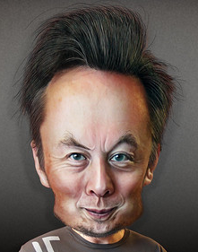
WHY TWITTER ?
Twitter is the second biggest social network platform after Facebook which generate 347,222 tweets every minute and 21 million tweets per hour. Twitter is one of the most popular sites where people used to express their feelings and reviews for a particular product. So, it creates an opportunity for data mining and sentiment analysis.
This Photo by Unknown Author is licensed under CC BY

Slide 6
Project Overview
The 2022 World Cup in Qatar, which kicked off November 20, is the most expensive World Cup ever, with costs reaching $220 billion.
Brazil extended its lead over second-placed Belgium in the latest FIFA rankings released on 27 October 2022 to take the field as the top-ranked team at this year's World Cup in Qatar, started 20 November 2022.
All eyes on Messi: Former England defender Jamie Carragher tweeted after his Lusail masterclass that Messi is "the best there has ever been".

Slide 7
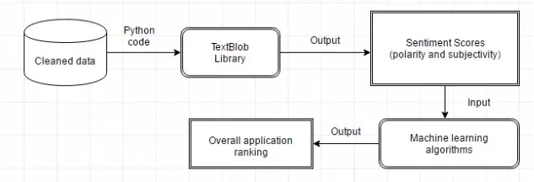
Workflow of Sentiment Analysis

Slide 8
Dataset and pre-processing
This dataset consists of 5 columns and 22,524 rows.
It consists of tweets from the day of the opening ceremony .
No : - It shows the Number of rows.
Tweet Time: -It represents the time the tweet was posted on the date of 20th November-2022.
Number of likes: - It shows how many likes tweets got
Source of Tweet: - It represents the device or web platform used to post that device.
Tweet: -It represents the complete tweet that was posted on Twitter. Example:- iPhone, iPad, Android, Adobe Express, Buffer, etc
Tweet for 24 hours in Opening Day Ceremony at 20 November 2022 GMT

Slide 9
Data Pre processing
Cleaning Tweet
Step G : Replacing Special Characters with space
Step A : Drop duplicate entities & Converting html entities
Step H : Replacing Numbers (integers) with space
Step B : Removing "@user" from all the tweets
Step C : Changing all the tweets into lowercase
Step I : Removing words whom length is 1
Step D : Apostrophe Lookup
Step J : WORD TOKENISATION
Step E : Short Word Lookup
Step K : remove stop words
Step F : Emoticon Lookup
Step L : Stemming

Slide 10
-: Stop words :-
We have used python’s built-in library stop words.
Stop words are words that don’t add to the overall meaning of our text.
This is done to reduce the size of the text and to avoid irrelevant information.
As we are solving such problems in sentiment analysis, for that we should remove stop words as they do not provide any relevant information to our model.
-: Stemming :-
Stemming is a rule-based approach because it slices the inflected words from prefix or suffix as per the need using a set of commonly underused prefix and suffix, like “-ing”, “-ed”, “-es”, “-pre”, etc. It results in a word that is actually not a word.
Here we have used porter stemming.

Slide 11
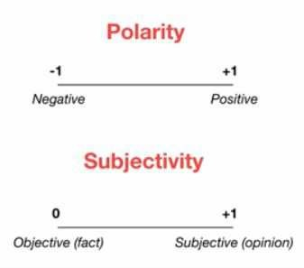
-: Linguistic Data Reprocessing :-
TextBlob is a python library that offers 6 simple API to access its methods to perform basic NLP
-: Steps :-
Collection of tweet
Sentimental Classification
Identifying polarity and subjectivity using TextBlob API.

Slide 12
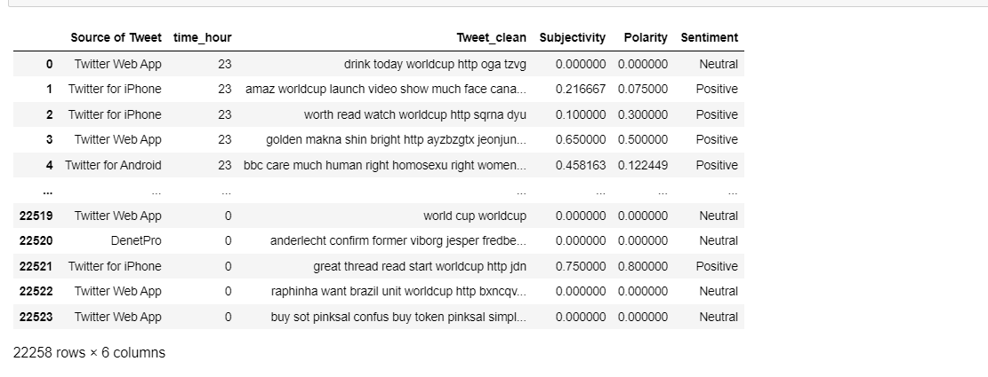
Output of Textblob
This shows subjectivity and polarity and also shows whether the tweet is Neutral, Positive or Negative.

Slide 13
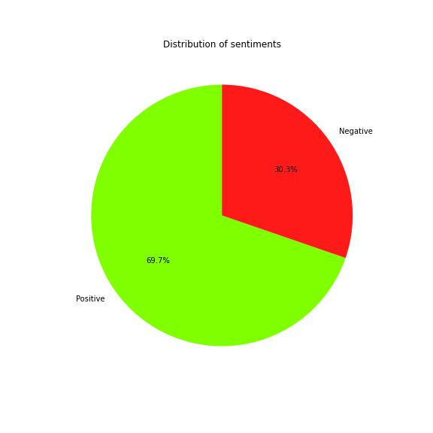
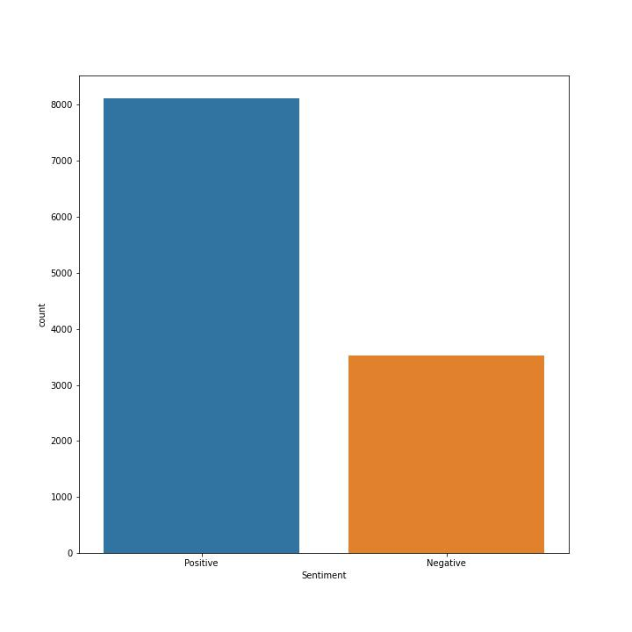
EDA & Visualization
The bar graph shows that there are almost 70% tweets are Positive while 30% tweets are Negative. In count it is approx. 3500 Negative tweets whereas 8000 tweets are Positive.

Slide 14
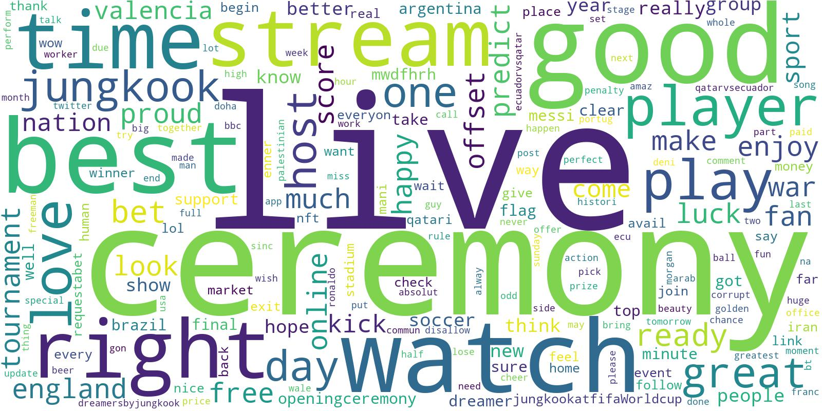
Most used words in Positive tweets.

Slide 15
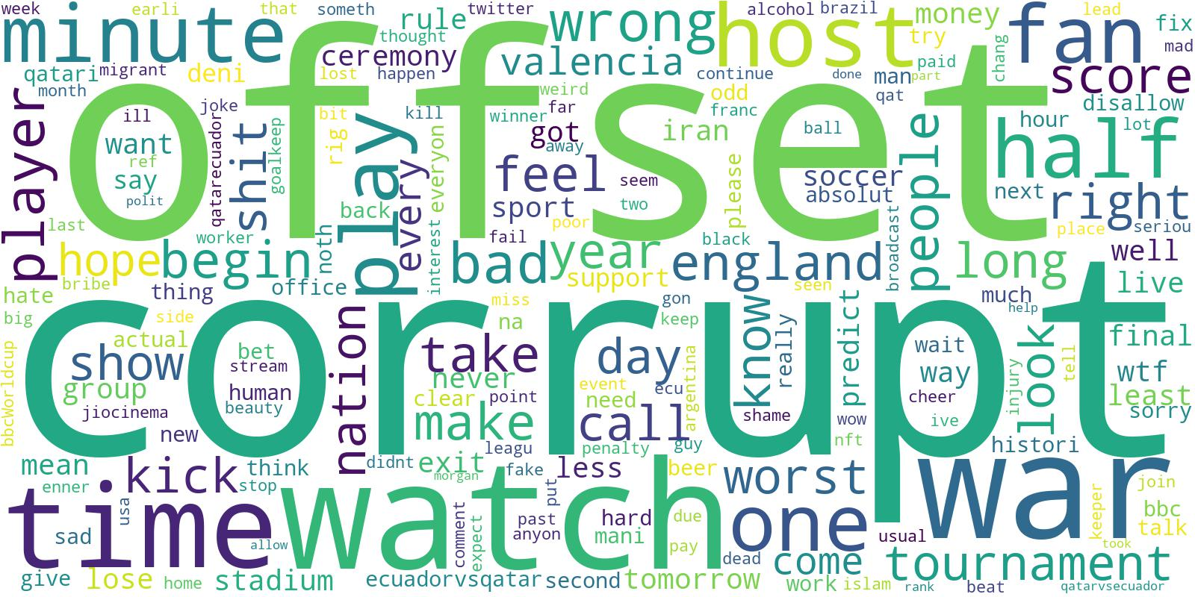
Most used words in Negative tweets.

Slide 16
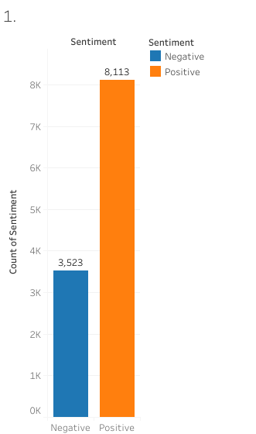
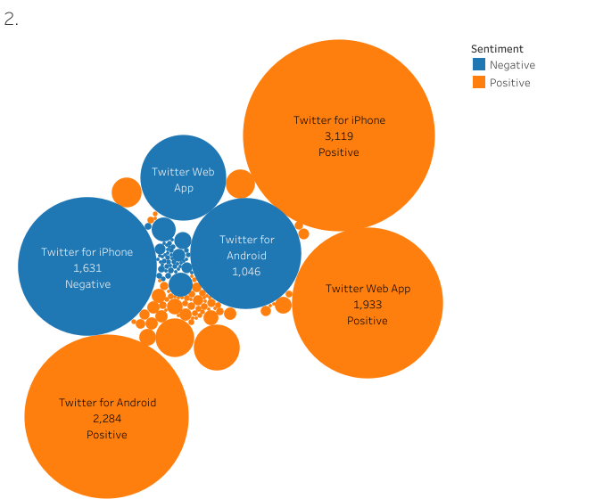

Slide 17
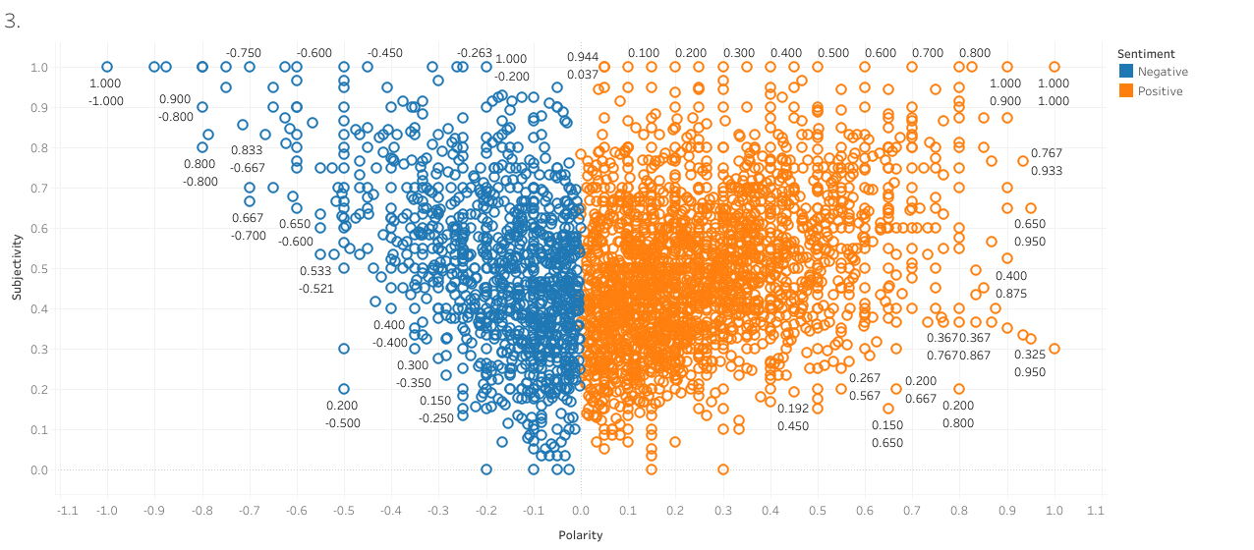
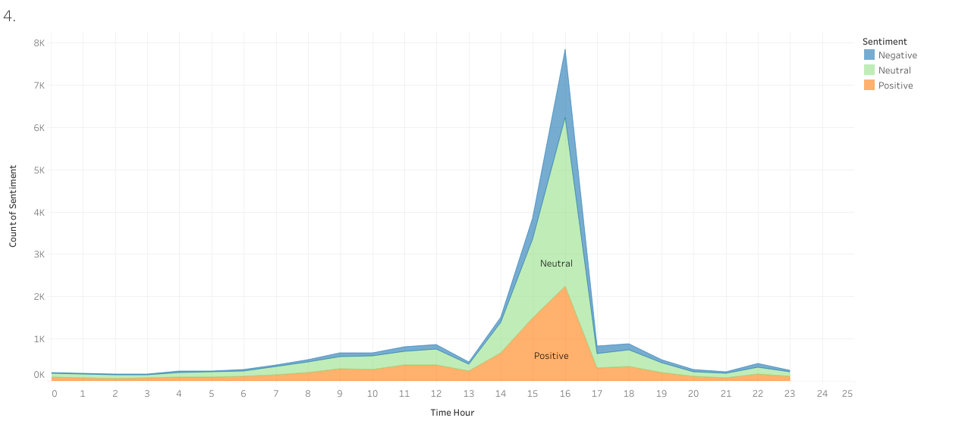

Slide 18
Model Building
Hyperparameter tunning :- Hyperparameter tunning is the process of finding optimal value for hyperparameter of machine learning model. Grid search is popular technique for hyperparameter tunning that involves searching over a predefined set of hyperparameter.
Grid search :- Grid search performs a systematic search through a range of hyperparameters, ensuring that all possible combinations are tested.
By optimizing hyperparameters, grid search can improve the overall performance of a model, leading to better accuracy, precision, recall, and F1 scores.

Slide 19
For our project, we have used TF-IDF vectorization stands for Term Frequency-Inverse document frequency.
80% training and 20% testing dataset as the thumb rule of machine learning.
We used grid search to tune hyperparameters for logistic regression, random forest, and naive byes.
Logistic regression:- For Logistic regression, we include the regularization parameter (C), the penalty term (L1 or L2), and the solver.
Random forest:- For Random forest, number of trees, the maximum depth of the trees, the minimum number of samples required to split an internal node.
Naive Bayes :- For Naive bayes hyperparameters that can be tuned include the smoothing parameter alpha.

Slide 20
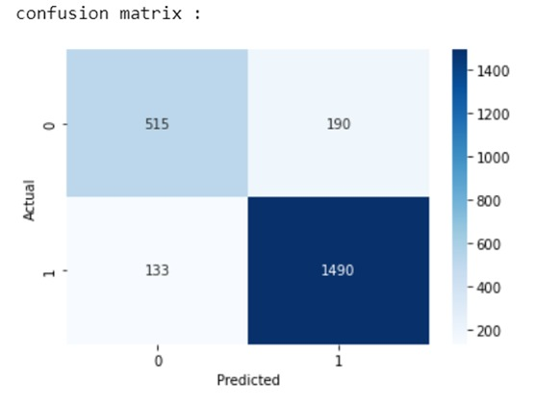
Model Evolution
After hyper parameter tunning, we got best parameter for each machine learning algorithm.
We used that parameter in our model, we got 86% accuracy with Logistic regression. For naive byes 81% and random forest 71%.We calculate confusion matrix for each :
TN(515) FP(190)
FN(133) TP(1490)
correctly classified 515 instances as negative and 1490 instances as positive (TP and TN)
incorrectly classified 190 instances as positive, which were actually negative (FP)
incorrectly classified 133 instances as negative, which were actually positive (FN)

Slide 21
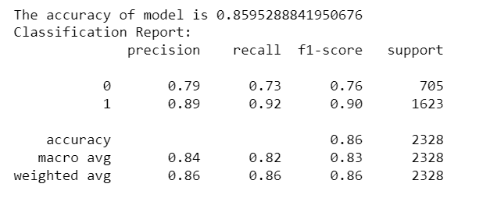
Model Evolution
This classification report provides several metrics to evaluate performance of machine learning
model that was trained on binary classification task.
Class 1 has higher precision, recall and f1 score, indicating better performance then class 0.

Slide 22
Limitations
There are several limitation to Twitter sentiment analysis,
Irony and sarcasm are common on Twitter, and they can be difficult to detect using sentiment analysis algorithms. A tweet that appears positive may actually be negative, and vice versa.
Noise: Twitter is a highly active platform, and there are many tweets that may not be relevant or contain meaningful sentiment data.

Slide 23
Conclusion
We conclude that Twitter users largely had positive sentiments towards FIFA2022, with some negative sentiments due to a few factors.
For tweets related to FIFA-2022, our machine learning classifier was highly accurate in predicting sentiment.
By using our analysis, organizers and stakeholders can gain valuable insight into how public perception can be enhanced and controversies can be better managed in the future.
With traditional sentiment analysis methods, it can be hard to detect sarcasm and irony on Twitter.
Sarcasm and irony detection could be explored in future work using advanced natural language processing techniques.

Slide 24
References
Machine Learning | BOW+ TF-IDF in Python For Unsupervised Learning by Eleonora Fontana
Machine Learning | Tuning Hyperparameters Logistic Regression Menggunakan Grid Search #UcupStory by Adipta Martulandi
Machine Learning | Twitter Sentiment Analysis by Anand Kumar
Machine Learning | Twitter Sentiment Analysis using a Classification Algorithm by Pallavi Gupta
Machine Learning | Sentiment Analysis — Let TextBlob do all the Work! by Abdul Hafeez Fahad
Machine Learning | Twitter Sentiment Analysis with full code and explanation (Naive Bayes) by Koshu Takatsuji

Slide 25

Thank you

